Slide 1
Einat Minkov University of Haifa, Israel CL course, U. Trento March 2, 2017

Slide 2
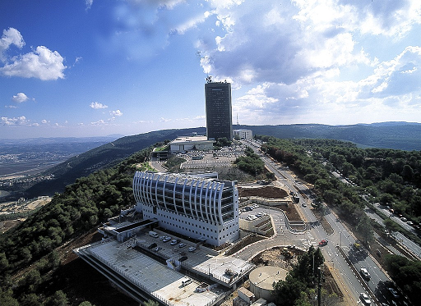

Slide 3
About myself
2008, PhD from the Language Technologies Institute at Carnegie Mellon University, USA
2008-10, Nokia Research, Cambridge, USA
2010-present, U.Haifa, Israel Teaching: Intro. to AI, text mining, Databases
Main research focus: semantics, graph-based inference, information extraction

Slide 4
Information extraction
Extraction of structured factual information from text
This should be useful for:
Question answering
Information aggregation
Main tasks:
Named entity recognition
Event extraction
Auto. construction of knowledge bases (ontologies)

Slide 5
Information extraction
Extraction of structured factual information from text
Event extraction
Question answering
Text
(processed)
Named entity recognition
Document indexing and search
Ontology construction
Improved syntactic processing

Slide 6
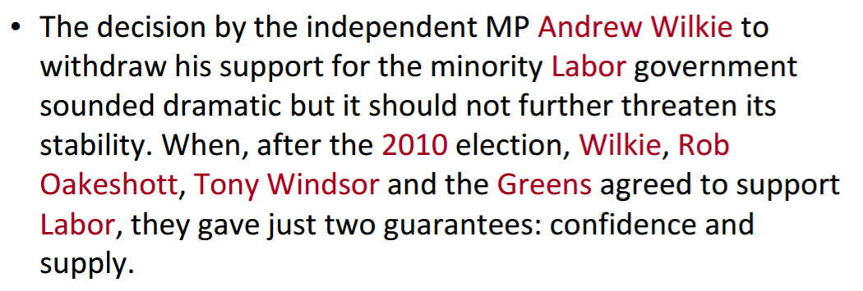
Named entity recognition
Find and classify names in text.

Slide 7
Named entity recognition
Find and classify names in text.

Slide 8
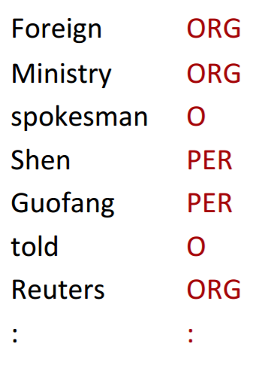
Named entity recognition
Often addressed as a tagging task, using rule-based or using statistical learning, considering:
the string value formatting (is it capitalized? Does the word end with `ski’?)
lexicon lookups (does `shen’ appear in a dictionary of first person names? or, `ltd’ in the lexicon of company suffixes?)
Syntactic and lexical neighborhood (DET on the left? `MR.’ on the left?)

Slide 9
Named entity recognition
Applications:
Question answering (e.g., “WHO invented.. ?” “WHERE is the CL class?”)
Document indexing and linking
Preliminary step for higher level IE tasks…

Slide 10
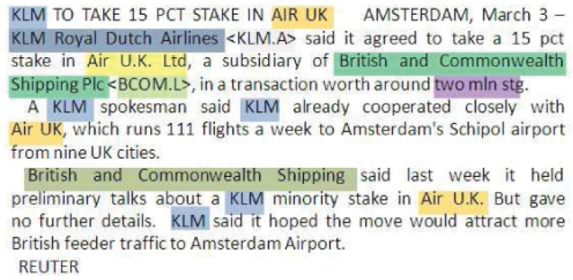
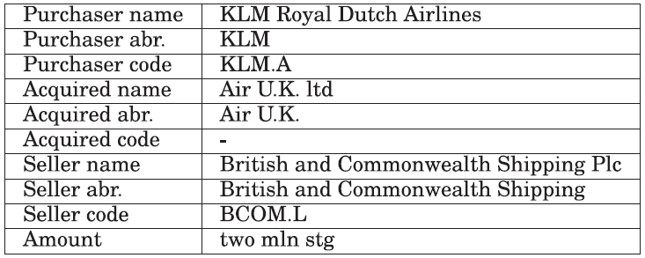
Extraction of events
Minkov & Zettlemoyer, ACL’12

Slide 11
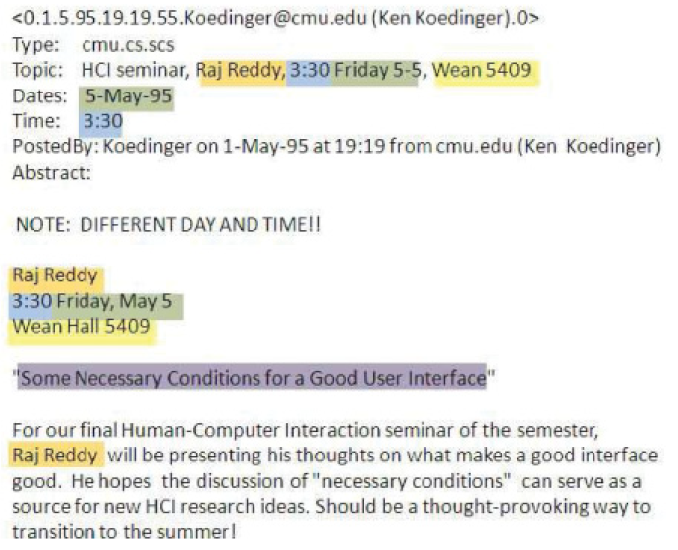
Extraction of events
Minkov & Zettlemoyer, ACL’12

Slide 12
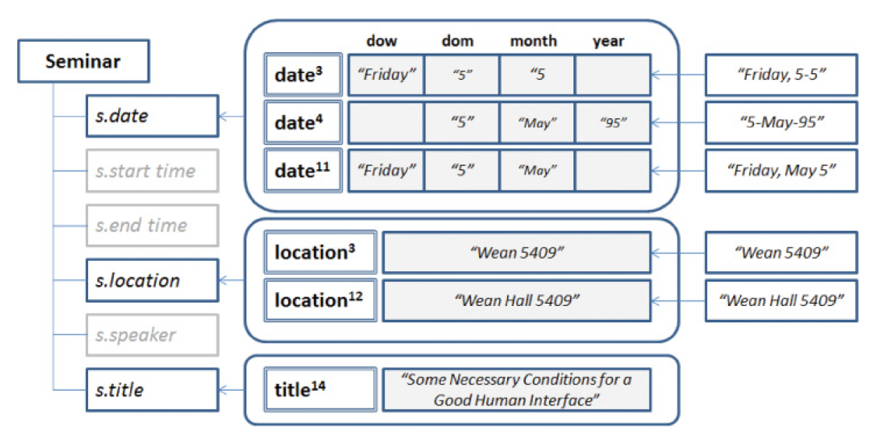
Extraction of events
Seminar slot population
Minkov & Zettlemoyer, ACL’12

Slide 13
Extraction of events
Seminar slot population
Minkov & Zettlemoyer, ACL’12

Slide 14
Extraction of events
The system’s output should `make sense’:
Start time of seminar before the end time..
The seminar doesn’t take place at night
And its duration is longer than 10 minutes and shorter than 2 hours..
The location is one of the rooms at CMU
We wish to have relevant world knowledge available
Minkov & Zettlemoyer, ACL’12

Slide 15
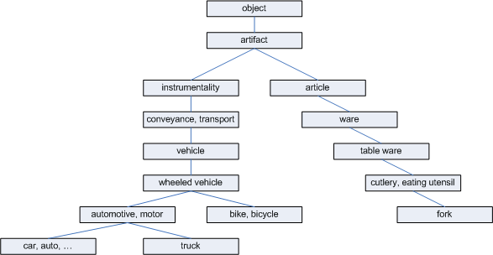
The holy grail: ontology of world knowledge
In addition to ‘is-a’ relations:
Synonym / antonym
Holonym / meronym
related / similar-to
…

Slide 16
Lexical knowledge for parsing
Structural ambiguities:
He broke [the window] [with a hammer]
He broke [the window] [with the white curtains]
Good probability estimates of P(hammer | broke, with) and P(curtains| window, with) will help with disambiguation
Toutanova, Manning & Ng, ICML’04

Slide 17
Lexical knowledge for parsing
Pair-wise statistics involving two words are very sparse, even on topics central to the domain of the corpus. Examples from WSJ (1million words):
stocks plummeted 2 occurrences
stocks stabilized 1 occurrence
stocks rose 50 occurrences
stocks skyrocketed 0 occurrences
stocks laughed 0 occurrences
Toutanova, Manning & Ng, ICML’04

Slide 18
Lexical knowledge for parsing
stabilize
stabilized
stabilizing
morphology
rise
climb
synonyms
skyrocket
rise
“is-a” relationships
Toutanova, Manning & Ng, ICML’04
Notes:
Examples with pictures

Slide 19
Using multiple similarity measures and chaining inferences
stocks
rose
rise
skyrocket
skyrocketed
Toutanova, Manning & Ng, ICML’04
Notes:
More nodes and links; show a path

Slide 20
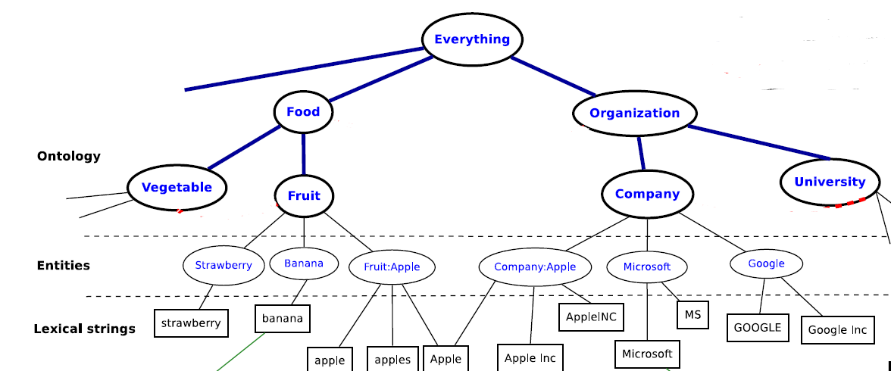
The holy grail: ontology of world knowledge
Why `holy grail’?
1. It is a hard task
2. World knowledge is very dynamic
Dalvi, Minkov, Talukdar & Cohen, WSDM’04

Slide 21
Relation extraction
Entity
subclass
subclass
subclass
Organization
Person
Location
subclass
subclass
subclass
subclass
subclass
Country
Scientist
Politician
subclass
subclass
instanceOf
instanceOf
State
Biologist
instanceOf
Physicist
City
instanceOf
Germany
instanceOf
instanceOf
locatedIn
Oct 23, 1944
Erwin_Planck
diedOn
Kiel
locatedIn
Schleswig-Holstein
FatherOf
bornIn
Nobel Prize
hasWon
instanceOf
citizenOf
Oct 4, 1947
diedOn
Max_Planck Society
Max_Planck
Angela Merkel
Apr 23, 1858
bornOn
means(0.9)
means
means
means
means(0.1)
“Max Planck”
“Max Karl Ernst Ludwig Planck”
“Angela Merkel”
“Angela Dorothea Merkel”
YAGO: Yet Another Great Ontology
[Suchanek et al.: WWW’07]

Slide 22
Automatic KB population
Gazetteers, tables, and text-based:
General `Hearst patterns’ (92):
Learning type-specific contexts:

Slide 23
Knowledge Bases and NLP
KBs used for text processing tasks:
Named entity recognition
Event extraction
Entity linking and disambiguation
Question answering
Syntactic structures being increasingly used for KB population and fact extraction
e.g., “Leveraging Linguistic Structure For Open Domain Information Extraction”, Angeli, Premkumar & Manning, ACL’15
Still an open question how to effectively interface language with world knowledge

Slide 24
Thank you!
einatm@is.haifa.ac.il

